Slide 1



DR.SIVANTHI ADITANAR COLLEGE OF ENGINEERING
TEAM LEADER
A.CROSSWIN
TEAM MEMBERS
N.BALA ABISHEK
M.PRAVEEN KUMAR
P.MANIKANDA PRABU

Slide 2
How To Create A Brand Promo Video Using Canva

Slide 3

BRAND LOGO

Slide 4
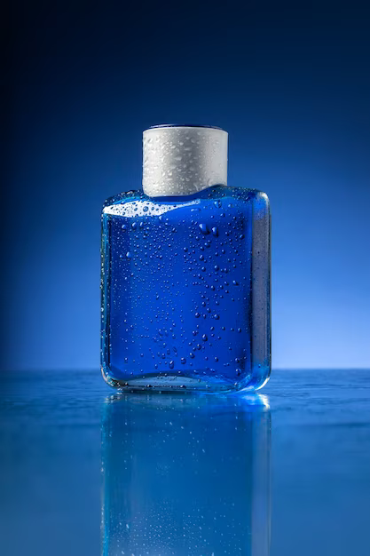
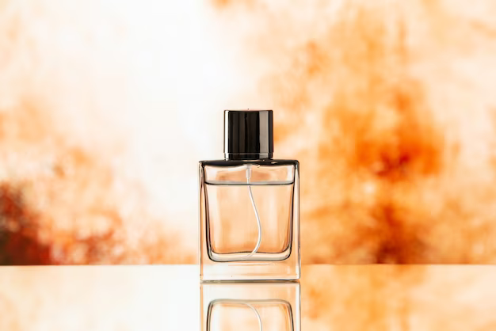
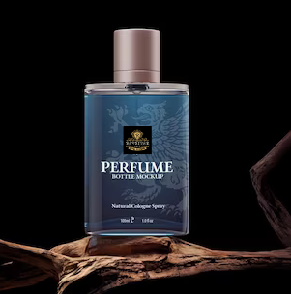
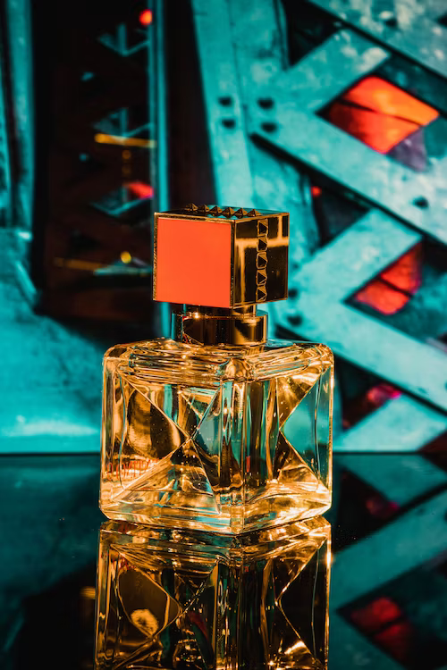
OUR COLLECTIONS
Sovereign Essence
Nobel Trigger
Monarch’s Aroma
Regal Elixir

Slide 5
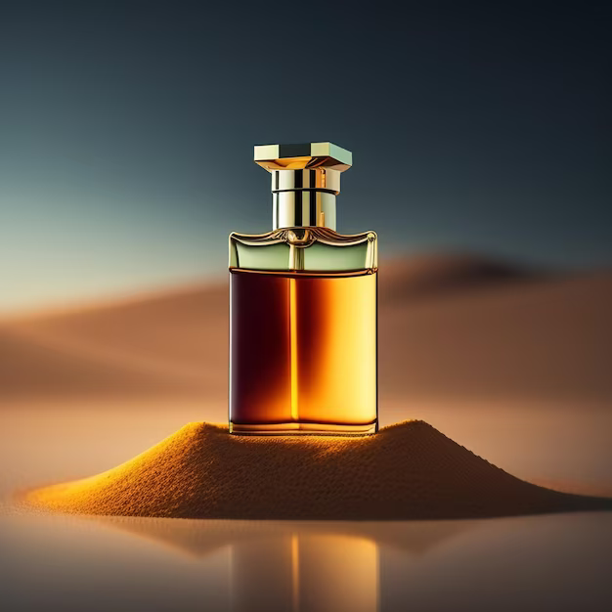
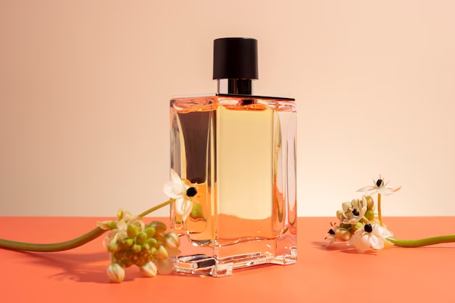
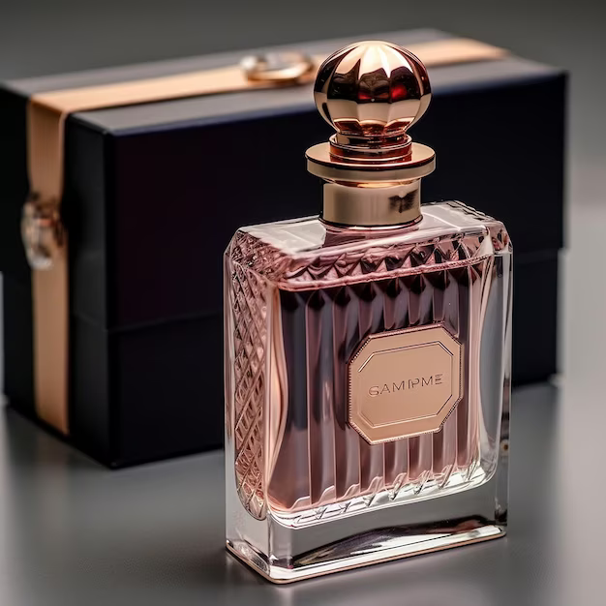
NEW ARRIVALS
Mystic whispers
Oppulent obsession
Eternal Enhancement

Slide 6

EXCLUSIVE OFFER
Regal Elixir
₹ 1000

Slide 7

COMPANY WEBSITE
www.revolver.com

Slide 8
THANK YOU

